Slide 1
Human Activity Recognition
Edwin Candinegara

Slide 2
Objectives
Real-time Smartphone based Human Activity Recognition
Smartwatch based Human Activity Recognition
Notes:
= Data collection process → documentation
= Activity description
Versus available data currentls

Slide 3
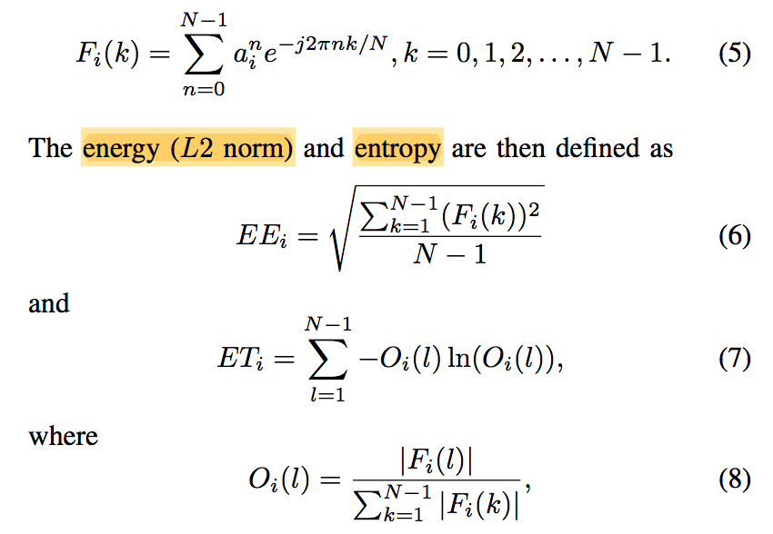

Features
Mean
$a_{x},a_{y},a_{z},a_{mag}$
Variance
$a_{x},a_{y},a_{z},a_{mag}$
Energy
$a_{x},a_{y},a_{z},a_{mag}$
Entropy
$a_{x},a_{y},a_{z},a_{mag}$
Correlation
$a_{xy},a_{xz},a_{xmag},a_{yz},a_{ymag},a_{zmag}$

Slide 4
Resolved Issues
Smartwatch application must be closed and reopened for every data collection session
This somehow prevents the jumping timestamp problem
Documented in the “data collection” documentation

Slide 5
Data Collection Method
Smartwatch is used on the right hand
Smartphone is always in the right pocket, facing down and outwards
For activities with multiple data collection:
Each data collection session will generate one set of data files
Conduct sampling and data windowing
Merge the windows into one file (combined by sensor source)
Generate features for each window (data is still separated between Smartphone and Smartwatch)
Combine generated features into one file for each activity type
Combine all activity data into one huge file (containing data from multiple activity

Slide 6
Data Summary
Activities | Duration | Activities | Duration
Walking | 5 minutes | Typing (keyboard, sitting) | 5 minutes
Running | 6 minutes | Writing (pencil, sitting) | 5 minutes
Lying | 5 minutes | Reading (book, sitting) | 6 minutes
Sitting | 6 minutes | Eating (sitting) | 4.5 minutes
Standing | 6 minutes | Folding (clothes, standing) | 6 minutes
Going Upstairs | 6 minutes | Sweeping the Floor | 6 minutes
Going Downstairs | 6 minutes | Brushing (standing) | 6 minutes

Slide 7
Data Summary
10 Hz, 1s window size, half-overlapping: 8695 data points
Activities | Data Points | Activities | Data Points
Walking | 578 | Typing (keyboard, sitting) | 518
Running | 674 | Writing (pencil, sitting) | 579
Lying | 518 | Reading (book, sitting) | 651
Sitting | 676 | Eating (sitting) | 516
Standing | 676 | Folding (clothes, standing) | 676
Going Upstairs | 645 | Sweeping the Floor | 676
Going Downstairs | 642 | Brushing (standing) | 670

Slide 8
Data Summary
10 Hz, 2s window size, half-overlapping: 4327 data points
Activities | Data Points | Activities | Duration
Walking | 288 | Typing (keyboard, sitting) | 258
Running | 336 | Writing (pencil, sitting) | 289
Lying | 258 | Reading (book, sitting) | 324
Sitting | 336 | Eating (sitting) | 257
Standing | 336 | Folding (clothes, standing) | 336
Going Upstairs | 321 | Sweeping the Floor | 336
Going Downstairs | 318 | Brushing (standing) | 334

Slide 9
Data Summary
10 Hz, 3s window size, half-overlapping: 2875 data points
Activities | Data Points | Activities | Duration
Walking | 192 | Typing (keyboard, sitting) | 172
Running | 222 | Writing (pencil, sitting) | 192
Lying | 172 | Reading (book, sitting) | 213
Sitting | 224 | Eating (sitting) | 171
Standing | 224 | Folding (clothes, standing) | 224
Going Upstairs | 213 | Sweeping the Floor | 224
Going Downstairs | 210 | Brushing (standing) | 222

Slide 10
Results
Experiments (5-folds):
SVM
Random Forest

Slide 11
Random Forest
Number of estimators = 10
The bigger the window size, the better it is!
SP = Smartphone
SW = Smartwatch
Sampling Frequency | Window Size | Accuracy Mean (SP + SW) | Accuracy Mean (SP) | Accuracy Mean (SW)
10 Hz | 1 second | 95.53% | 89.8% | 89.72%
10 Hz | 2 seconds | 96.51% | 92% | 92.51%
10 Hz | 3 seconds | 98.19% | 93.4% | 94.78%

Slide 12
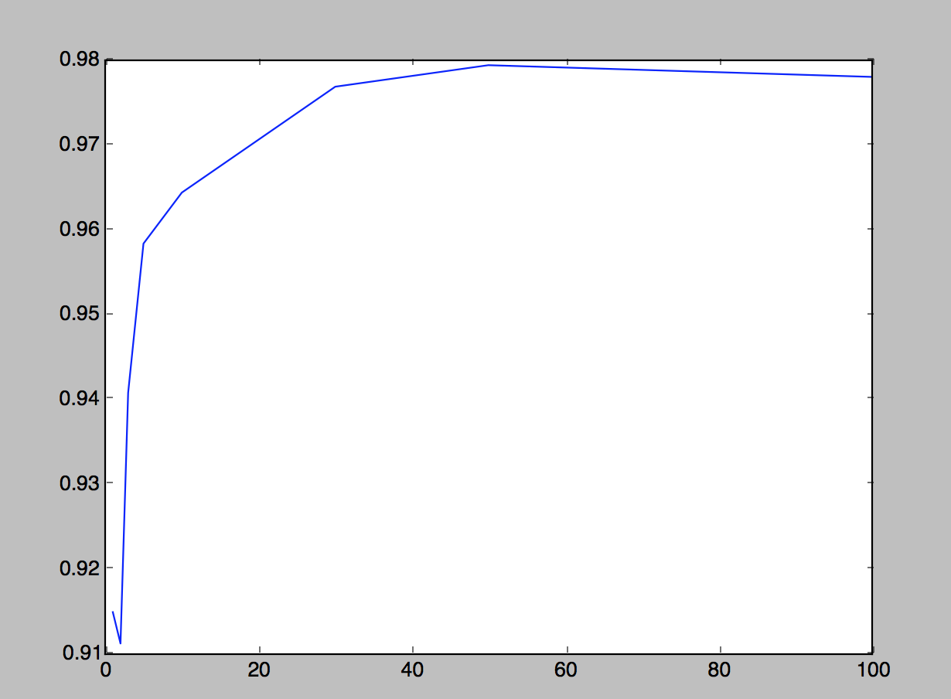
Random Forest (SP + SW)
Sampling frequency = 10 Hz
Window size = 2s
Number of Estimators tested:
1, 2, 3, 5, 10, 20, 30, 50, 100
Above 50 estimators, it seems it is overfitting the training data

Slide 13
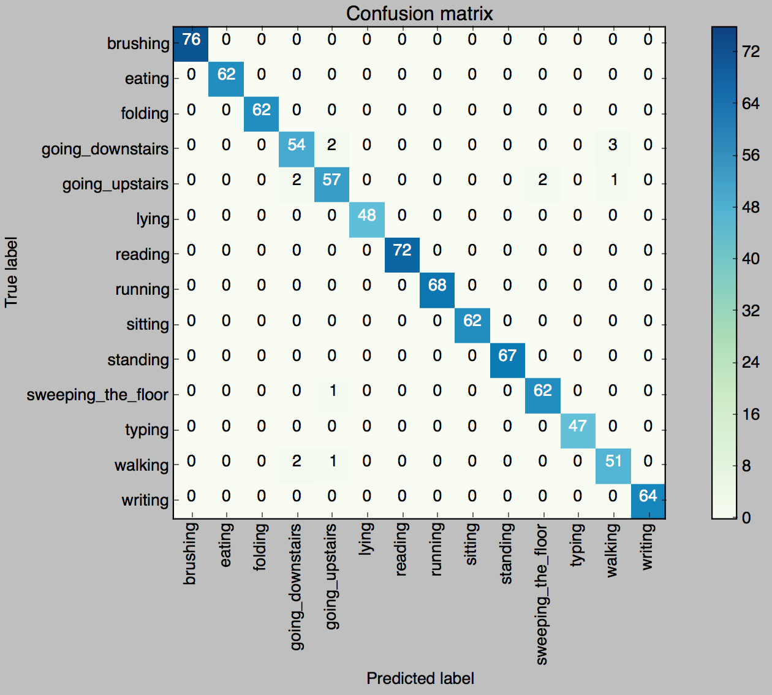
Random Forest (50 estimators, SP + SW)
Please note that the confusion matrix is symmetrical

Slide 14
SVM
C = 10, kernel = RBF
The bigger the window size, the better it is!
SP = Smartphone
SW = Smartwatch
Sampling Frequency | Window Size | Accuracy Mean (SP + SW) | Accuracy Mean (SP) | Accuracy Mean (SW)
10 Hz | 1 second | 94.39% | 79.25% | 82.10%
10 Hz | 2 seconds | 96.33% | 82.92% | 86.67%
10 Hz | 3 seconds | 96.87% | 85.88% | 87.17%

Slide 15
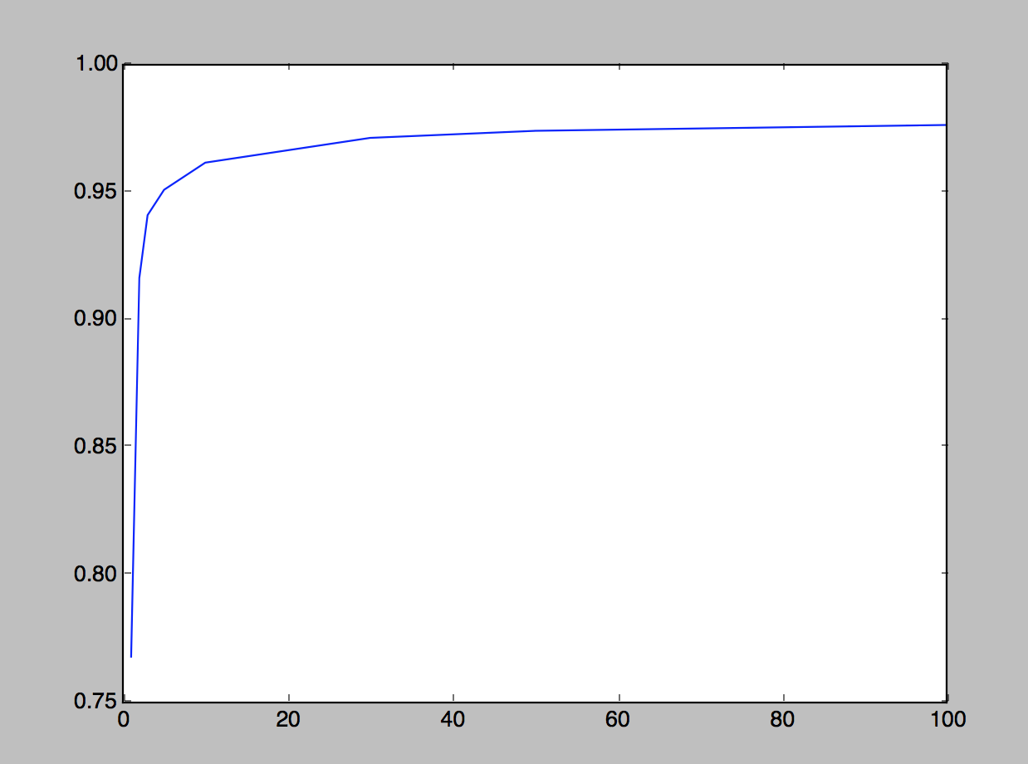
SVM (SP + SW)
Sampling frequency = 10 Hz
Window size = 2s
Kernel = RBF
Cost Value tested:
1, 3, 5, 10, 30, 50, 100
The bigger the cost (C) is, the better it is!

Slide 16
Observations
Random Forest has better performance in general compared to SVM
RF has higher accuracy even when we are only using the Smartphone or Smartwatch data alone
The performance of the models trained only with Smartwatch data is better than if it is trained only with Smartphone data
This may be because most of the activities examined put more focus on the hand movements

Slide 17
What’s next?
Try other models:
HMM (still looking for a good implementation in Python)
Naive Bayes
RBM
MLP
Gather friends’ data (focus more on this)

